Slide 1
IUBAT – International University of Business Agriculture and Technology
Analysis and predict the absenteeism for making a decision on Employees in working place
Course Code: Csc 488(Thesis) Prepared for: Thesis defense Committee Department of Computer Science and Engineering
Supervised by:
Dr. Abhijit Saha Professor, Department of Computer Science and Engineering
Prepared by:
Md. KAMRUL HASAN
ID: 18103012

Slide 2
Table of Contents
Introduction
Literature Review
Research Methodology
Proposed System Architecture
Work Plan
Result
Discussion
Conclusion
Reference

Slide 3
Introduction

Slide 4
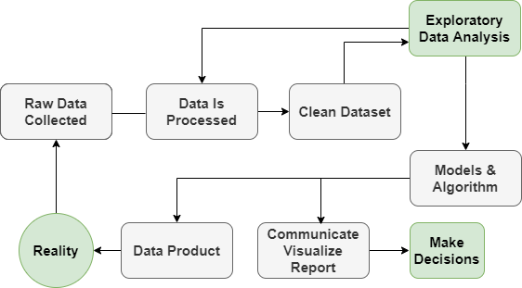
What is Data Science?
Process Flow of Data Science

Slide 5
Absenteeism
What is Absenteeism ?
Take leave from office during the working hours
irregular in the office

Slide 6
Absenteeism(cont.)
Applications:
E-commerce
Healthcare
Transport
Manufacturing
Finance
Banking
Different challenges in this field:
The individual and team performance in the organization
The Cause of sickness, child care, diseases and so on of an employee
Effects of absenteeism

Slide 7
Motivations
Many companies is facing the problem of absenteeism
No proper way to judge the employees behavior, manner, and irregularity.
poor excuses for missing work

Slide 8
Problem Statement
Personal excuses and individual employees performance.
Unavailability of the individual employees office working hours record
No records of individual team members involvement in a project
Organization might be loss the profit due to absenteeism

Slide 9
Research Questions
should we predict whether an employee is expected to be absent or not?
How would we measure absenteeism?
Can it measure accurately?
should we rather think about trying to predict excessive absenteeism?
Is this functionality being very complex?

Slide 10
Objectives
To propose a system that will analyze and predict the absenteeism for making a decision on Employees in working place.
To make the regression, quantitative and qualitative analysis of employees absenteeism for predicting the different types of variables.
To find and select the appropriate tools for measuring the different variables of employees.
To find out the Age vs Average absence probability
To make a decision making approach based on analysis and prediction of employees variables.

Slide 11
Literature Review

Slide 12
Literature Review 1
Thirulogasundaram, V. P., & Sahu, P. C. (2014). Job satisfaction and absenteeism interface in corporate sector–A study. IOSR J Humanities Social Sci, 19(3), 64-68.
Proposed System:
The main objective of this study is to find out the reality of absenteeism of employees on their duty.
Impact of motivation and job satisfaction on absenteeism

Slide 13
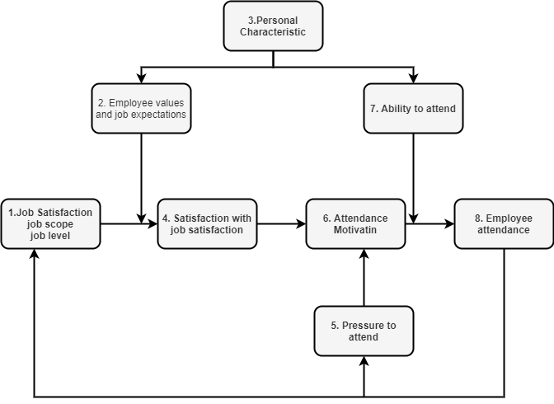
Literature Review 1(cont.)
Block Diagram of proposed systems with variable:

Slide 14
Literature Review 1 (cont.)
Limitations:
Job satisfaction is not only the reason for absenteeism.
In this design Not applied the quantitative and qualitative analysis to get accurate result.
In this research does not use maximum numbers of variable.

Slide 15
Literature Review 2
Grigore, O. M. (2020). Factors contributing to work-related absenteeism during the COVID-19 pandemic. Management Dynamics in the Knowledge Economy, 8(4), 401-418.
Proposed System:
Perspective the profile of the absent employee
Impact on companies
Influence of the personal, attitudinal, and organizational factors
Feature of presence policies implemented in the context of the coronavirus pandemic

Slide 16
Literature Review 2(cont.)
Limitations:
Describing only age , education and year of experience variables
Not used any machine learning technique or any statistical method like regression.

Slide 17
Research Methodology

Slide 18
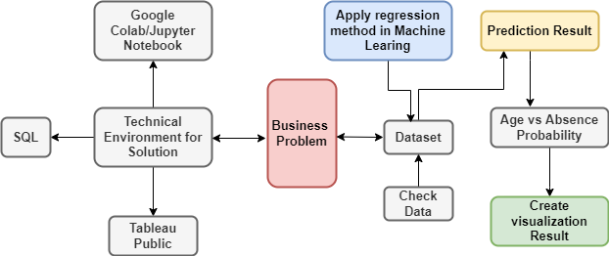
Proposed System Architecture

Slide 19
System Requirements
Software Requirements:
Windows, Mac, Linux operating system or use google colab
Jypyter Note Book
MySQL workbrech
Tableu Public
Hardware Requirements:
Core i5 processor and 8GB RAM of Computer for better performance

Slide 20
Research Methods
Collecting the dataset
Data will be secondary data in my research
Data preprocessing
Organize the data and check whether data missing or not
Machine Learning Process
Applying here statistical method Like regression, quantitative, qualitative analysis.
Loading the absenteeism module
It methods used for prediction
Analyzing the predicted outputs in Tableau
Visualize the data analysis with graph

Slide 21
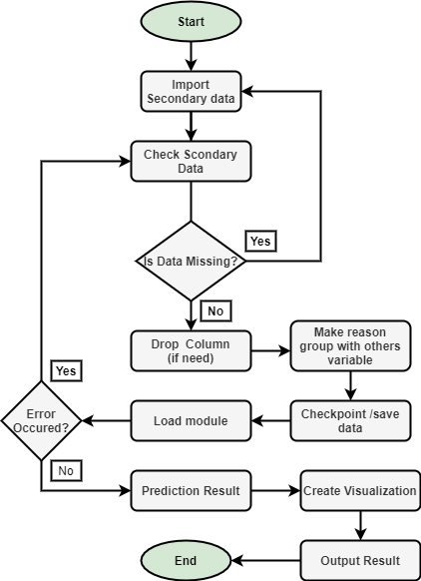
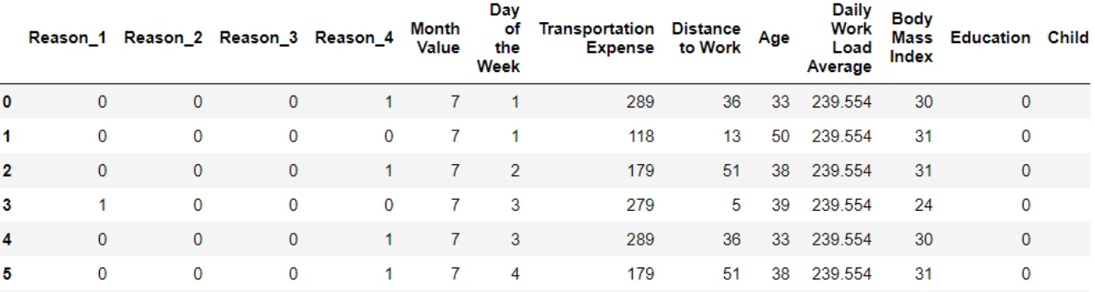
Flow Chart of Proposed System

Slide 22
Proposed work Plan

Slide 23
Work Plan
Analysis and prediction of employees absenteeism will be tested through the appropriate tools.
Decision making will be achieved based on the testing results.
The proposed system benefits and limitations will be addressed and discussed accordingly.

Slide 24
Result
Age vs Avg. absence probability result:
Age | Average Absence Probability
28 | 59%
30 | 27%
31 | 35%
33 | 45%
34 | 50%
36 | 45%
37 | 36%
39 | 30%
40 | 20%
43 | 51%
46 | 57%
48 | 10%
50 | 64%
53 | 8%
58 | 63

Slide 25
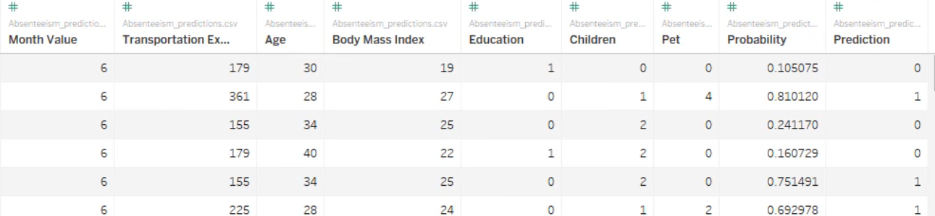
Result Contd..
Data load in Tableau Public

Slide 26

Result Contd..
Age data Initialization

Slide 27
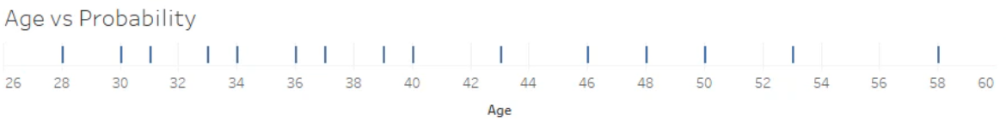
Result Contd..
Selected the dimension

Slide 28
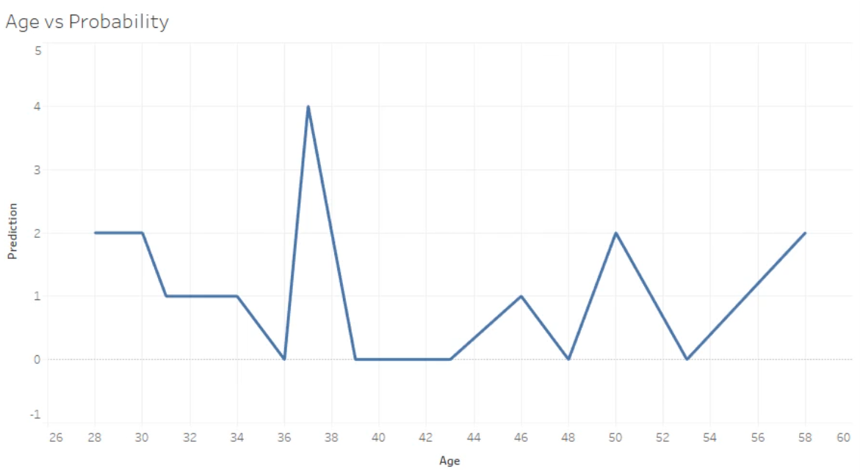
Result Contd..
Add prediction field with the age

Slide 29
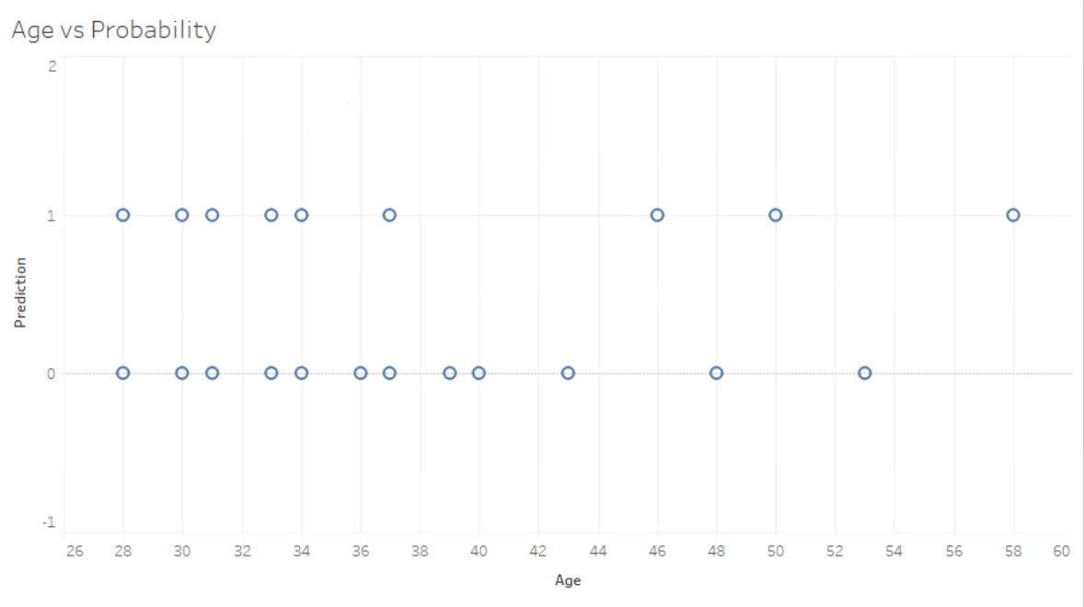
Result Contd..
Shows age vs prediction value

Slide 30
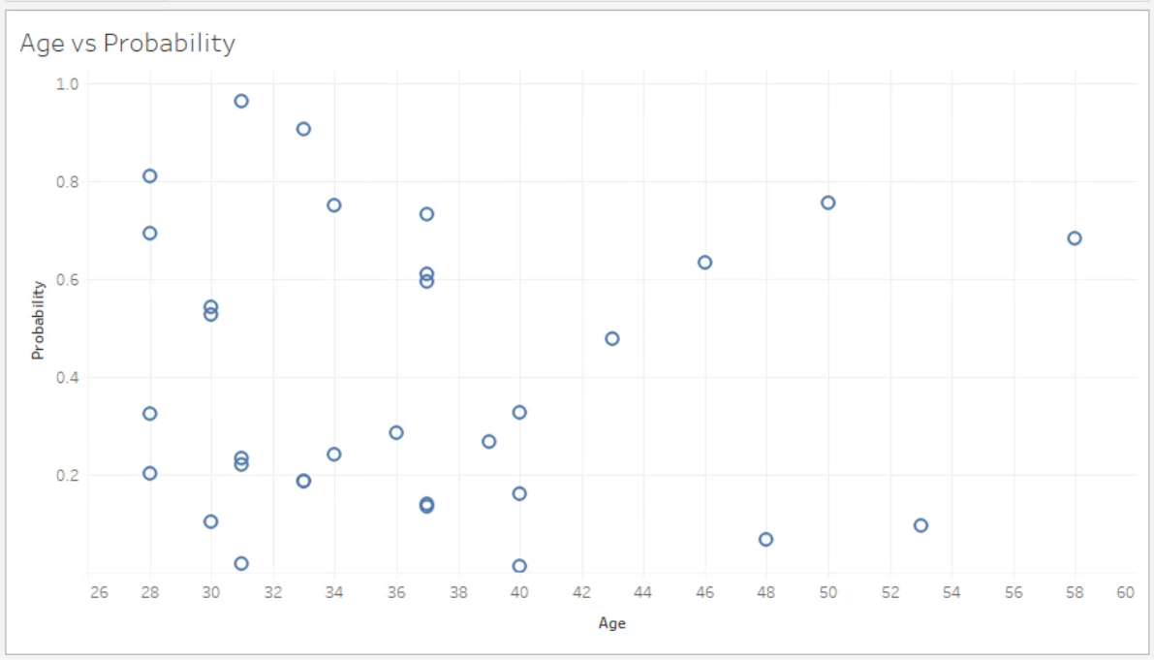
Result Contd..
Shows age vs absence probability

Slide 31
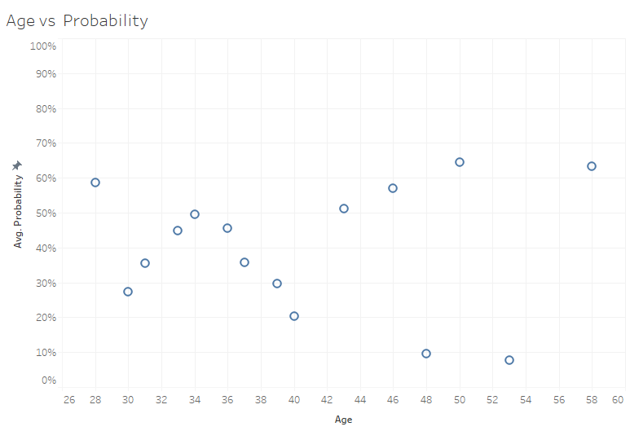
Result Contd..
Age vs Avg. absence probability

Slide 32
Discussion
cover only the small part of the absenteeism analysis under the Data Science.
Research limitation is only used logistic regression for implementation.
applied logistic regression in machine learning
used numpy library, pandas library, mathplot library, google colab
complexity that we have faced during testing to get train accuracy
Train Accuracy 77% and Test Accuracy 74%

Slide 33
Discussion Contd..
small percentage difference between the train and test accuracy
visualize the result that time we identify age vs prediction and
Age vs average absence probability percentage
Tried to implemented age vs absence probability
Future direction reason vs probability and also transportation expense vs probability

Slide 34
Conclusion
In this thesis, a system has been proposed to analyze and predict the absenteeism for making a decision on Employees in working place.
Tools are Jupyter Notebook, SQL Workbench, Tableu will be utilized
By this analysis, organization can be benefited
correctly measure the age vs average probability

Slide 35
Conclusion contd..
Model train accuracy with 77%
Test Accuracy is 74 %
Finally we visualize the result
can apply this model in organizations to solve the business problems

Slide 36
References
Cucchiella, F., Gastaldi, M., & Ranieri, L. (2014). Managing absenteeism in the workplace: the case of an Italian multiutility company. Procedia-Social and Behavioral Sciences, 150, 1157-1166.
Grigore, O. M. (2020). Factors contributing to work-related absenteeism during the COVID-19 pandemic. Management Dynamics in the Knowledge Economy, 8(4), 401-418.
Gouws, W. J. S. (2015). The relationship between absenteeism and physical workplace conditions at Tshepong mine (Doctoral dissertation, University of the Free State).
Omari, G.C., Manyele, S.V. and Mwaluko, G., 2019. Analysis of Measured Employees’ Absenteeism in the Forensic Science Laboratory. Engineering, 11(3), pp.137-166.
Thirulogasundaram, V. P., & Sahu, P. C. (2014). Job satisfaction and absenteeism interface in corporate sector–A study. IOSR J Humanities Social Sci, 19(3), 64-68.
VanWormer, J. J., Linde, J. A., Harnack, L. J., Stovitz, S. D., & Jeffery, R. W. (2012). Weight change and workplace absenteeism in the HealthWorks study. Obesity facts, 5(5), 745-752.

Slide 37
Any Questions?

Slide 38
Thank You

